Slide 1


Capstone Project
Cricket Win Prediction
Rohit Akut

Slide 2
Agenda
1
Introduction
2
Data Preparation
3
Methodology & Model Building
4
Model Tuning & Selection
5
Conclusion & Recommendations
Presentation Title

Slide 3
Data Prep
Data cleaning
Erroneous value treatment
Dropping of variables
Null & Missing value treatment using Mean, Median, Mode
EDA to understand variable relationships

Slide 4
Introduction – Business problem & understanding
The business opportunity in this project lies in the potential to revolutionize the way cricket matches are strategized and played. By leveraging data analytics and machine learning, the Board of Control for Cricket in India (BCCI) aims to gain a competitive edge in the sport.
This also introduces another unbiased factor when choosing players based on their merits and past data.
From a business perspective, this project could lead to more victories for the Indian Cricket Team, enhancing the team’s reputation and potentially leading to increased revenue. With a few tweaks this can be used in other team sports as well
Objective: Enhance India’s cricket performance by creating accurate Machine Learning models that predict match wins. Extract actionable insights from historical data and recommend strategies to further increase chances of future wins.

Slide 5

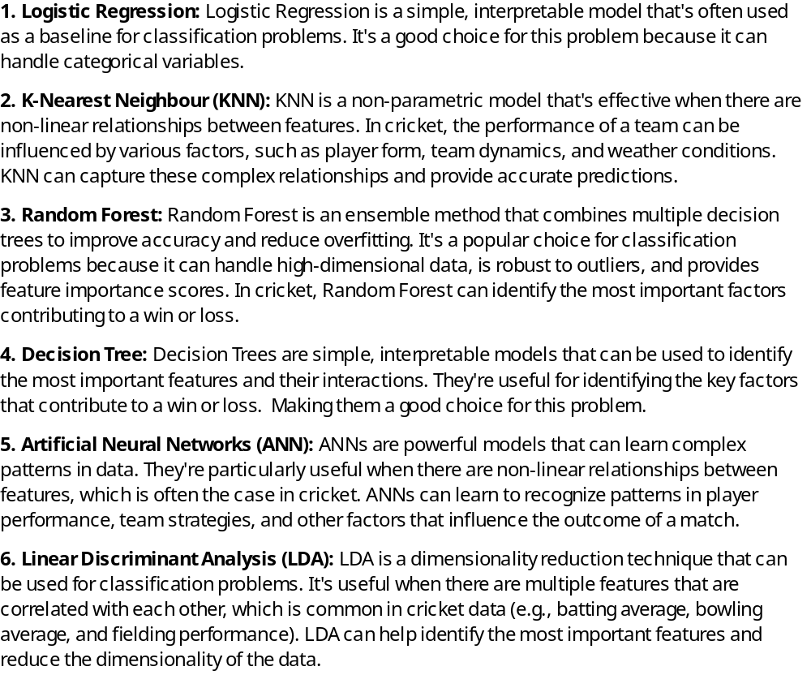
Model Selection approach
Since we encounter a classification problem which is WIN/LOSS We needed to chose models wisely as cricket is an unpredictable game and as such the models we chose needed to vary in degrees of robustness, accuracy, tackle overfitting and work with a hugely biased dataset. Can handle categorical and numerical variables. Can capture non-linear relationships between features. Provide insights into feature importance and interactions
By trying out different models, we can compare their performance and choose the one that works best for our specific problem. As , the best model is not always the most complex one - it’s the one that performs best on unseen data.

Slide 6


Model | Set | Accuracy | Precision | Recall
Logistic Regression | Train | 0.64 | 0.04 | 0.08
 | Train | 0.84 | 1.00 | 0.91
 | Test | 0.89 | 0.06 | 0.11
 | Test | 0.84 | 1.00 | 0.91
KNN | Train | 0.71 | 0.37 | 0.49
 | Train | 0.89 | 0.97 | 0.93
 | Test | 0.48 | 0.20 | 0.29
 | Test | 0.86 | 0.96 | 0.90
Decision Tree | Train | 1.00 | 1.00 | 1.00
 | Train | 1.00 | 1.00 | 1.00
 | Test | 0.80 | 0.72 | 0.76
 | Test | 0.95 | 0.97 | 0.96
Random Forest | Train | 1.00 | 1.00 | 1.00
 | Train | 1.00 | 1.00 | 1.00
 | Test | 0.98 | 0.73 | 0.84
 | Test | 0.95 | 1.00 | 0.97
LDA | Train | 0.65 | 0.25 | 0.36
 | Train | 0.87 | 0.97 | 0.92
 | Test | 0.58 | 0.22 | 0.32
 | Test | 0.86 | 0.97 | 0.91
Neural Network | Train | 0.17 | 1.00 | 0.29
 | Train | 0.00 | 0.00 | 0.00
 | Test | 0.16 | 1.00 | 0.28
 | Test | 0.00 | 0.00 | 0.00
Model building

Slide 7
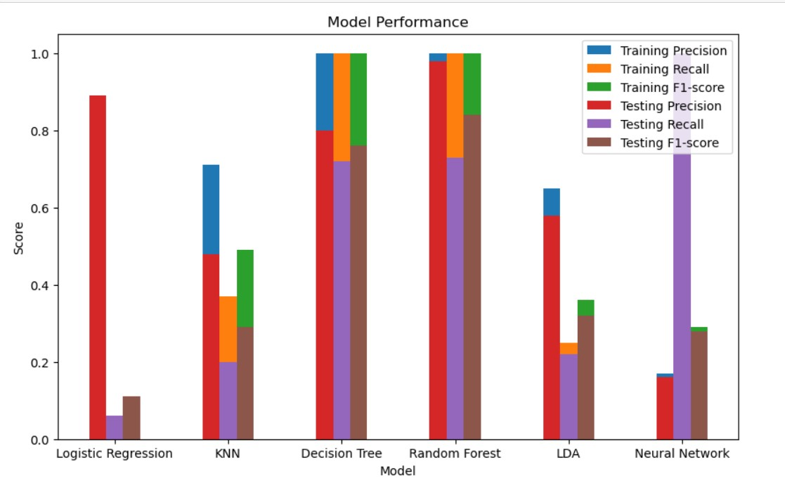
Model performance – Pre-Tuning

Slide 8
Tuning of models via ensemble techniques like SMOTE & Bagging model Performance post SMOTE
Neural Network Model (Post Bagging)
Metric | Class 0 | Class 1 | Accuracy
Training Set
Precision | 1 | 1 | 1
Recall | 1 | 1 | 1
F1-score | 1 | 1 | 1
Support | 327 | 1675 | 2002
Testing Set
Precision | 0.86 | 0.95 | 0.94
Recall | 0.75 | 0.97 | 0.94
F1-score | 0.8 | 0.96 | 0.94
Support | 143 | 715 | 858
Model | Dataset | Class 0 | Class 1 | Accuracy
Decision Tree | Test | 0.93 | 0.97 | 0.95
Decision Tree | Train | 1.00 | 1.00 | 1.00
Random Forest | Test | 0.99 | 0.99 | 0.99
Random Forest | Train | 1.00 | 1.00 | 1.00
LDA model performance
Metric | Class 0 (Pre-SMOTE) | Class 1 (Pre-SMOTE) | Weighted Avg (Pre-SMOTE) | Class 0 (Post-SMOTE) | Class 1 (Post-SMOTE) | Weighted Avg (Post-SMOTE)
Precision | 0.65 | 0.87 | 0.83 | 0.76 | 0.77 | 0.76
Recall | 0.25 | 0.97 | 0.86 | 0.77 | 0.76 | 0.76
F1-Score | 0.36 | 0.92 | 0.83 | 0.77 | 0.76 | 0.76
Accuracy | - | - | 0.86 | - | - | 0.76

Slide 9
Best Fit Model
As per our extensive analysis we recommend Random Forest model as the best one for our purpose
Why Random Forest
Consistency: Random Forest performs well on both the train and test sets, with high precision, recall, and F1-score values for both classes (0 and 1).
High Accuracy: Random Forest achieves the highest accuracy on both the train (1.00) and test (0.95) sets, indicating that it is able to correctly predict the outcome of cricket matches.
Balanced Performance: Random Forest shows balanced performance on both classes, with high precision and recall values for both win (class 1) and loss (class 0) predictions.
Robustness: Random Forest is a robust model that is less prone to overfitting, which is evident from its consistent performance on both the train and test sets.

Slide 10
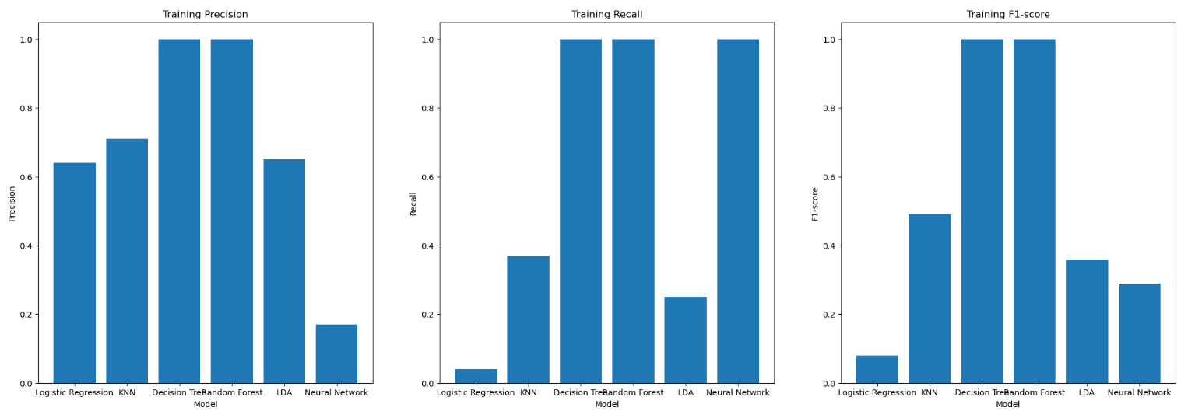
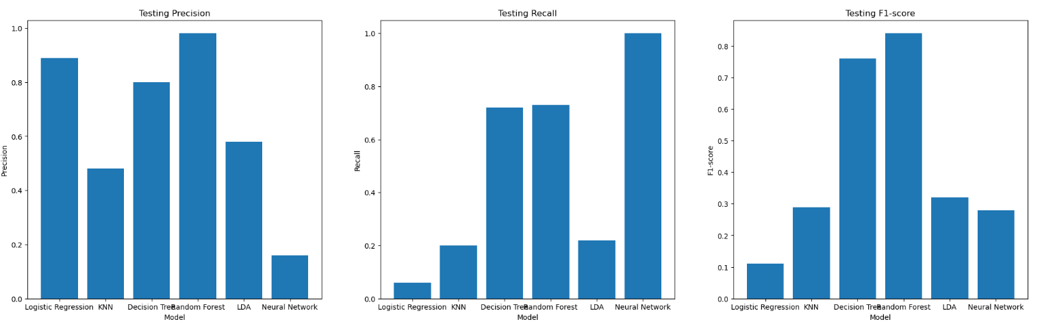
Model comparison

Slide 11
Insights & Recommendations
Batting Approach: Select technically sound batsmen who can handle swing bowling.
Fielding Adjustments: Emphasize slip catching practice due to the likelihood of edges in such conditions.
Spin Strategy: Utilize spinners in the middle overs to control the run rate.
Power Hitters: Include batsmen who can clear the boundary in the later overs.
Pace Attack: Bring in fast bowlers who can bowl cutters and slower balls effectively.
Top Order Stability: Ensure top-order batsmen build a solid foundation to allow for aggressive play later.
All-Rounder Utilization: Play an extra all-rounder to provide depth in both batting and bowling.
Opening Partnership: Focus on a strong start from the openers to set the pace of the innings.
Fielding Focus: Prioritize fielding drills to ensure sharpness in the field.
Finishers’ Role: Assign clear roles to finishers to maintain or accelerate the run rate towards the end.
Rest & Recuperation : Ensure that players get enough rest and time to recuperate between matches to enhance their performance and consistency.
For each match, the strategies should be tailored to the opponent’s weaknesses and the conditions on the day. Continuous analysis of player performance and opposition tactics will be crucial for adapting strategies throughout the series. Additionally, maintaining player fitness and morale will be essential for the team’s success.

